Slide 1




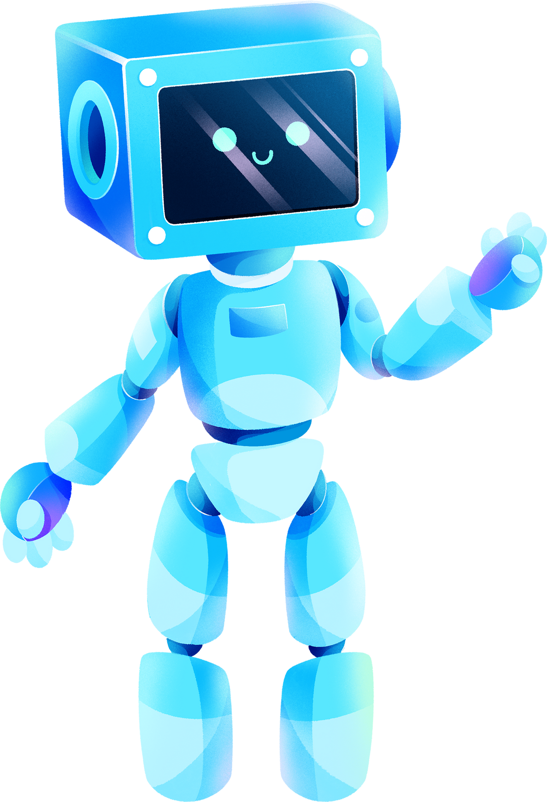
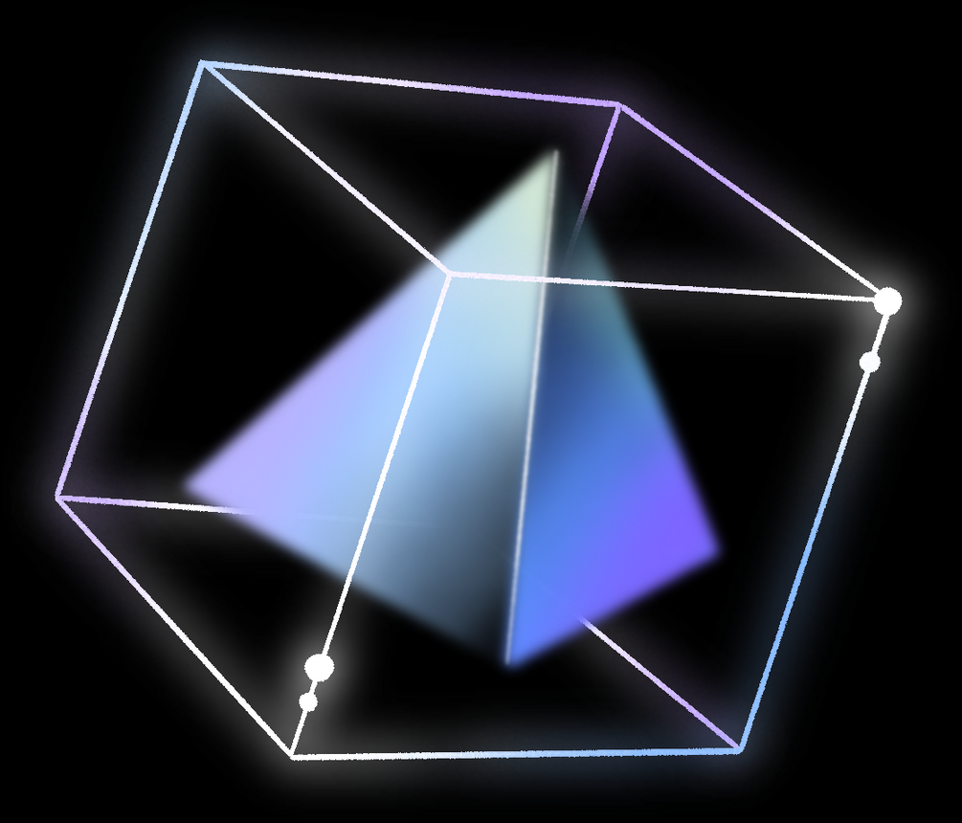
OASIS INFOBYTE
JAVA DEVELOPMENT INTERNSHIP
PROJECT PRESENTATION
Presented by :
JEEVAN H

Slide 2



PROJECT 1
ONLINE RESERVATION SYSTEM

Slide 3






PROJECT OBJECTIVES
LOGIN FORM
RESERVATION SYSTEM
CANCELLATION FORM
To access this Online Reservation System, each user should have a valid login Id and password. After providing the correct login Id and password, users will able to access the main system.
Under reservation form users will have to fill the necessary details such as their basic details, train number, train name will automatically come in the box, class type, date of journey, from (place) to destination and after that users will have to press insert button.
If passengers want to cancel their tickets then they have to provide their PNR number and after submitting it, this will display the entire information related to that particular PNR number. If users want to confirm their cancellation, in this case they have to press OK button.

Slide 4


PROJECT ARCHITECTURE
Microservices using Spring framework
Eureka server
admin-service
user-service
Note : As of now there's no communication between the services, but they can be included on further upgradation.

Slide 5
Entity Relationship Diagram :
source
adminName
adminPassword
trainName
dest
trainNumber
dateOfJourney
numberOfSeats
costPerSeat
adminId
adminEmail
t_Id
time
classtype
cId
a_id
Organization
AdminAccess
TrainDetails
ClassType
1
M
1
Has
N
Saves
1
lastName
firstName
userPassword
reserves
trainNumber
trainName
name
email
pnrNumber
source
userName
age
N
rId
dest
UserId
phoneNum
dateOfJourney
uId
Users
1
N
Reservation
time
Does
classtype
totalCost
numberOfSeats

Slide 6
PROJECT 2
NUMBER GUESSING GAME

Slide 7
PROJECT OBJECTIVES
RANDOM NUMBER GENERATION
GUESS THE NUMBER
ADDITIONAL FEATURES
The system generates a random number from a given range of numbers.
The user is promoted to enter the guessed number in a displayed dialogue box.
The computer then tells if the entered number matches the guessed number or it is higher/lower than the generated number.
Attempts are limited to 4.
In total there are 3 rounds.
Score will be displayed after each round. And the final score will be displayed at the end of the game.

Slide 8


PROJECT ARCHITECTURE
GUI - Java Swing
Java Swing is being used to build the GUI for this application.
The main components used here are :
JPanel
JLabel
JFormatedTextField
JButton
Algorithm
There are 3 rounds in the game.
As the user proceeds to the next round the difficulty level increases i.e. ( The range of numbers gets increased after each round).
The credit points gets incremented and multiplied by the current round. There's no decrement of points on false answer.

Slide 9
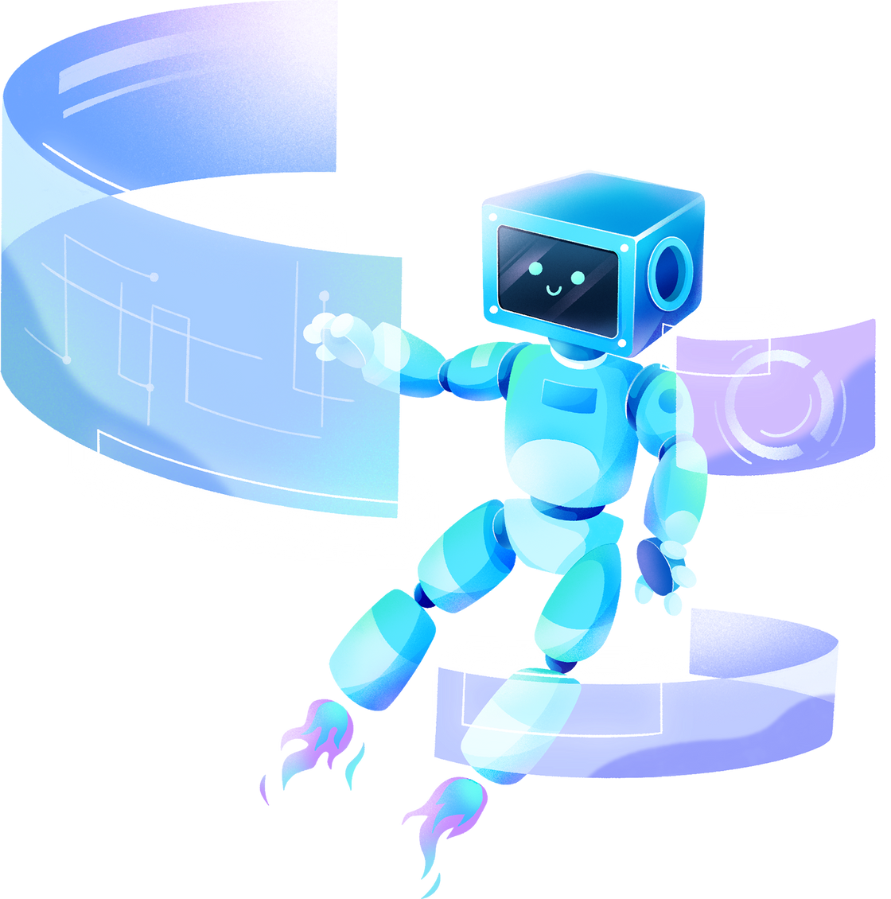
THANK YOU!

Slide 10



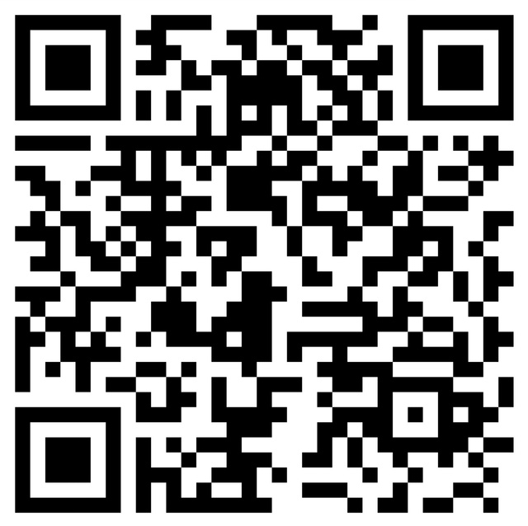
FOR THE COMPLETE VIDEO SCAN THE QR CODE

